Slide 1
Clipping and 3D object representation Concepts
Unit 2

Slide 2
The Viewing Pipeline
A world-coordinate area selected for display is called a window.
An area on a display device to which a window is mapped is called a viewport.
The window defines what is to be viewed; the viewport defines where it is to be displayed.
Often, windows and viewports are rectangles in standard position, with the rectangle edges parallel to the coordinate axes.

Slide 3
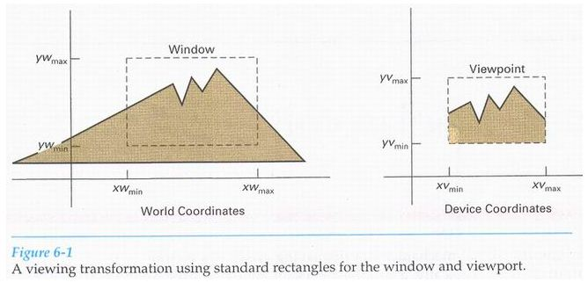
In general, the mapping of a part of a world-coordinate scene to device coordinates is referred to as a viewing transformation.
Sometimes the 2D viewing transformation is simply referred to as the window-to-viewport transformation or the windowing transformation.
Following figure illustrates the mapping of a picture section that falls within a rectangular window onto a designated rectangular viewport.

Slide 4
In computer graphics terminology, the term window originally referred to an area of a picture that is selected for viewing.
Some graphics packages that provide window and viewport operations allow only standard rectangles, but a more general approach is to allow the rectangular window to have any orientation.
Viewing transformation is carried out in several steps, which is called viewing-transformation pipeline.
First, we construct a scene in world coordinates using the output primitives and attributes.
To obtain a particular orientation for the window, we can setup a two-dimensional viewing-coordinate system in the world-coordinate plane, and define a window in the viewing-coordinate system.
Once the viewing reference frame is established, we can transform descriptions in world coordinates to viewing coordinates.

Slide 5
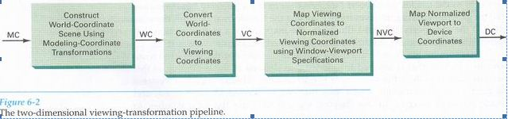
We then define a viewport in normalized coordinates in the range from 0 to 1 and map the viewing-coordinate description of the scene to normalized coordinates.
At the final step, all parts of the picture that lie outside the viewport are clipped, and the contents of the viewport are transferred to device coordinates.

Slide 6
By changing the position of the viewport, we can view objects at different positions on the display area of an output device.
Also, by varying the size of viewports, we can change the size and proportions of displayed objects.
We achieve zooming effects by successively mapping different-sized windows on a fixed-size viewport.
As the windows are made smaller, we zoom in on some part of a scene to view details that are not shown with larger windows.
More overview is obtained by zooming out from a section of a scene with successively larger windows.
Once the scene has been transferred to normalized coordinates, the unit square is simply mapped to the display area for the particular output device in use at that time.

Slide 7
When all coordinate transformations completed, viewport clipping can be performed in normalized coordinates or in device coordinates.
Clipping procedures are of fundamental importance in computer graphics.
They are used not only in viewing transformations, but also in window-manager systems, in painting and drawing packages to eliminate parts of a picture inside or outside of a designated screen area, and in many other applications.

Slide 8
Window-To-Viewport Coordinate Transformation
Once object descriptions have been transferred to the viewing reference frame, we choose the window extents in viewing coordinates and select the viewport limits in normalized coordinates as shown in following figure.
Object descriptions are then transferred to normalized device coordinates.
We do this using a transformation that maintains the same relative placement of objects in normalized space as they had in viewing coordinates.

Slide 9
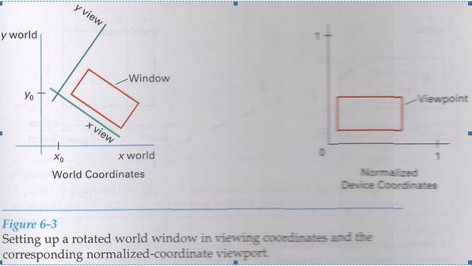

Slide 10
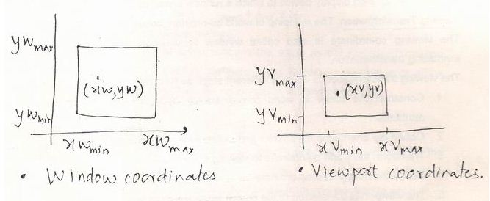
If a coordinate position is at the center of the viewing window, it will be displayed at the center of the viewport.
Following figure illustrates the window-to-viewport mapping.

Slide 11
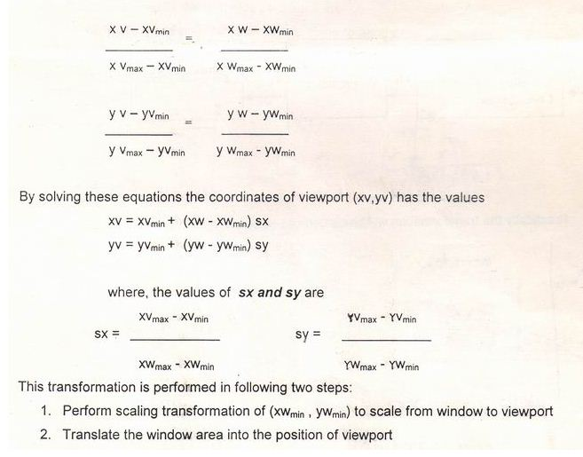
To maintain the same relative placement in the viewport as in the window, we require that,

Slide 12
Relative proportions of objects are maintained if the scaling factors are the same (sx = sy).
Otherwise, world objects will be stretched or contracted in either the x or y direction when displayed on the output device.
From normalized coordinates, object descriptions are mapped to the various display devices.
Any number of output devices can be open in a particular application, and another window-to-viewport transformation can be performed for each open output device. This mapping is called the workstation transformation.
Workstation transformation is accomplished by selecting a window area in normalized space and a viewport area in the coordinates of the display device.

Slide 13
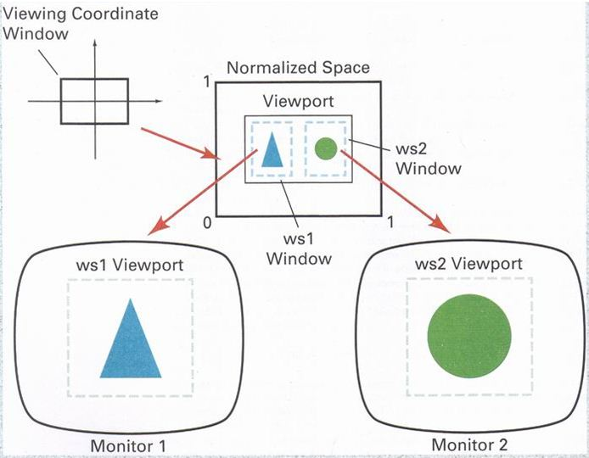

Slide 14
Clipping Operations
Any procedure that identifies those portions of a picture that are either inside or outside of a specified region of space is referred to as a clipping algorithm, or simply clipping.
The region against which an object is to clipped is called a clip window.
The clipping operation can be performed on different objects. Thus it can be divided as :
Point Clipping
Line Clipping
Area (Polygon) Clipping
Text Clipping
Curve Clipping

Slide 15
Point Clipping
Assuming that the clip window is a rectangle in standard position, we save a point P=(x,y) for display if the following inequalities are satisfied:
XWmin <= X <= XWmax
YWmin <= Y <= Ywmax
where the edges of clip window are (XWmin , XWmax , YWmin, Ywmax)
If any of the above equation is not satisfied then the point is clipped (not saved)

Slide 16
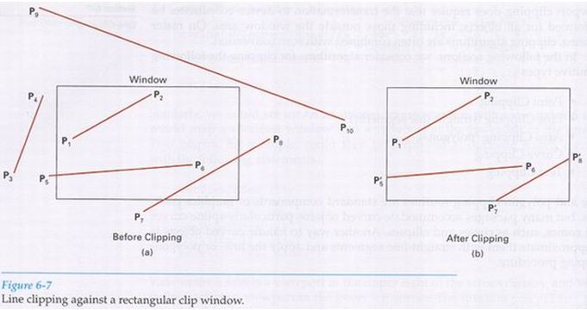
Line Clipping

Slide 17
Figure illustrates possible relationships between line positions and a standard rectangular clipping region.
A line-clipping procedure involves several parts.
First, we can test a given line segment to determine whether it lies completely inside the clipping window.
If it does not, we try to determine whether it lies completely outside the window.
Finally, if we cannot identify a line as completely inside or completely outside, we must perform intersection calculations with one or more clipping boundaries.
A line with both endpoints inside all clipping boundaries, such as the line from P1 to P2 is saved.

Slide 18
For the line with end points ( X1, Y1 ) & ( X2 , Y2 ) and one or both endpoints outside the clipping rectangle, the following parametric representation can be used;
X = X1 + u (X2 – X1)
Y = Y1 + u (Y2 - Y1)
0<= u <= 1
If the value of u for an intersection with a rectangle boundary edge is outside the range 0 to 1, the line does not enter the interior of the window at that boundary.
If the value of u is within the range of 0 to 1 then, it crosses the clipping area.

Slide 19
Cohen-Sutherland Line Clipping
This is one of the oldest and most popular line-clipping procedures.
Every line end-point in a picture is assigned a four-digit binary code, called a region code, that identifies the location of the point relative to the boundaries of the clipping rectangle.
Regions are setup in reference to the boundaries as shown in following figure.
Each bit position in the region code is used to indicate one of the four relative coordinate positions of the point with respect to the clip window: to the left, right, top, or bottom.

Slide 20
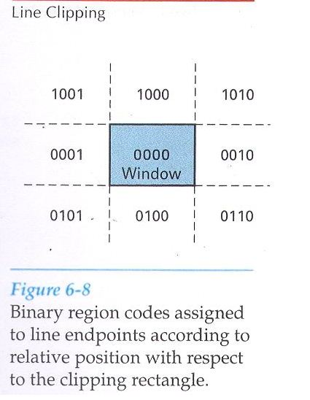

Slide 21
bit 1 represents : Left
bit 2 represents : Right
bit 3 represents : Below
bit 4 represents : Above
A value of 1 in any bit position indicates that the point is in that relative position; otherwise, the bit position is set to 0.
If a point is within the clipping rectangle, the region code is 00o0.
Bit values in the region code are determined by comparing endpoint coordinate values (x,y) to the clip boundaries.
Bit 1 is set to 1 if x < xwmin.
The other three bit values can be determined using similar comparisons.

Slide 22
By using such representation we can make following conclusions:
1. If the region code of both endpoints is 0000, then the line is completely inside.
2. If both the endpoints contain 1 in same bit position, then the line is completely outside. This can also be checked by logical AND operation. If the result is not 0000 then, line is completely outside.
3. If the line is not completely inside or outside, then we have to find out the intersection point of line with window.
The intersection points can be calculated with the help of slope m of a line which has endpoints ( X1, Y1 ) & ( X2 , Y2 ).
Y = Y1 + m ( X - X1) and X = X1 + (Y - Y1 ) / m
The equation of slope is given as, m = ( Y2 - Y1) / ( X2 – X1)
The values of X will be XWmin or XWmax and that for Y will by YWmin or WYmax.

Slide 23
Polygon Clipping
To clip polygons, we need to modify the line-clipping procedures discussed in the previous section.
A polygon boundary processed with a line clipper may be displayed as a series of unconnected line segments, depending on the orientation of the polygon to the clipping window.
What we really want to display is bounded area after clipping, as following figure.

Slide 24
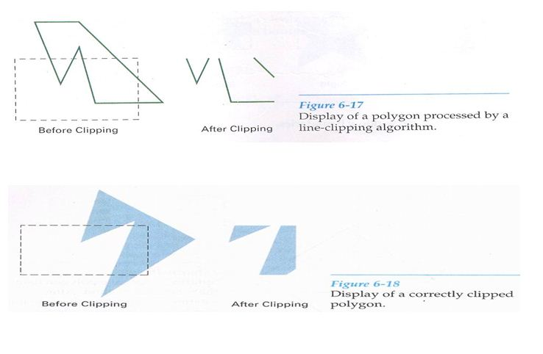

Slide 25
Sutherland-Hodgeman Polygon Clipping
We can correctly clip a polygon by processing the polygon boundary as a whole against each window edge.
This could be accomplished by processing all polygon vertices against each clip rectangle boundary in turn.
Beginning with the initial set of polygon vertices, we could first clip the polygon against the left rectangle boundary to produce a new sequence of vertices.
The new set of vertices could then be successively passed to a right boundary clipper, a bottom boundary clipper, and a top boundary clipper, as shown in following figure.

Slide 26
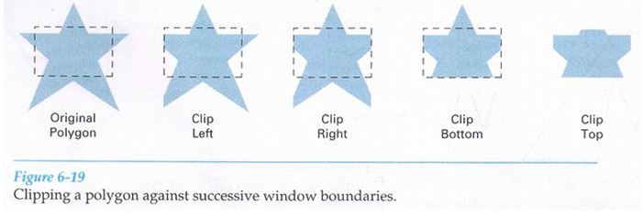
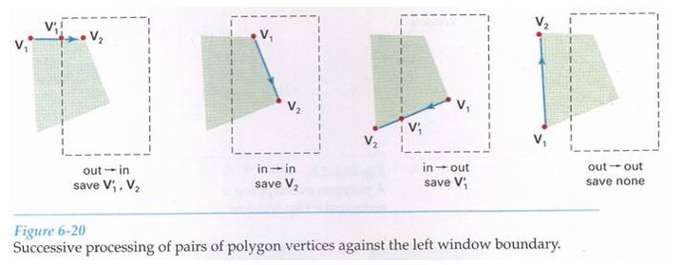

Slide 27
There are four possible cases when processing vertices in sequence around the perimeter of a polygon.
As each pair of adjacent polygon vertices is passed to a window boundary clipper, we make the following tests:
If the first vertex is outside the window boundary and the second vertex is inside, both the intersection point of the polygon edge with the window boundary and the second vertex are added to the output vertex list.
If both input vertices are inside the window boundary, only the second vertex is added to the output vertex list.
If the first vertex is inside the window boundary and the second vertex is outside, only the edge intersection with the window boundary is added to the output vertex list.
If both input vertices are outside the window boundary, nothing is added to the output list.

Slide 28
We illustrate this method by processing the area in following figure against the left window boundary.
Vertices 1 and 2 are found to be on the outside of the boundary.
Moving along to vertex 3, which is inside, we calculate the intersection and save both the intersection point and vertex 3.
Vertices 4 and 5 are determined to be inside, and they also are saved.
The sixth and final vertex is outside, so we find and save the intersection point.
Using the five saved point, we would repeat the process for the next window boundary.

Slide 29
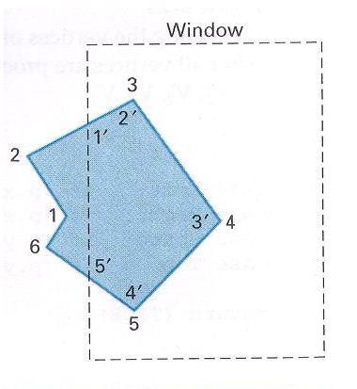

Slide 30
Weiler-Atherton Polygon Clipping
Here, the vertex-processing procedures for window boundaries are modified so that concave polygons are displayed correctly.
The basic idea in this algorithm is that instead of always proceeding around the polygon edges as vertices are processed, we sometimes want to follow the window boundaries.
Which path we follow depends on the polygon-processing direction (clockwise or counterclockwise) and whether the pair of polygon vertices currently being processed represents an outside-to-inside pair or an inside-to-outside pair.

Slide 31
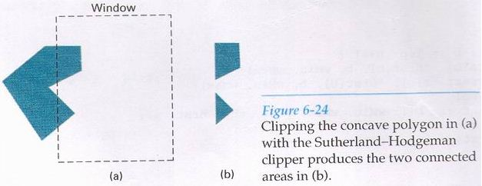
The basic idea for clock-wise processing of vertices is given as two rules:
For outside to inside pair of vertices, follow the polygon boundary.
For inside to outside pair of vertices, follow the window boundary.

Slide 32
Curve Clipping
Curve clipping procedures will involve nonlinear equations, however, and this requires more processing than for objects with linear boundaries.
The bounding rectangle for a circle or other curved object can be used first to test for overlap with a rectangular clip window.
If the bounding rectangle for the object is completely inside the window, we save the object.
If the rectangle is determined to be completely outside the window, we discard the object.

Slide 33
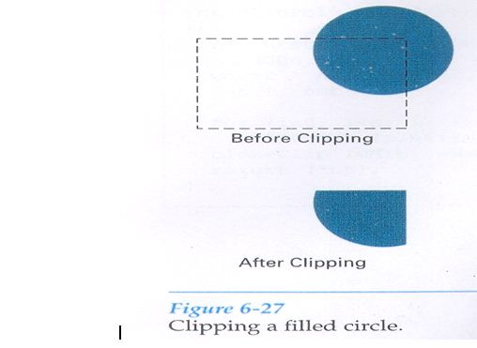
Else, for a circle, we can use the coordinate extents of individual quadrants and then octants for preliminary testing before calculating curve-window intersections.
For an ellipse, we can test the coordinate extents of individual quadrants.

Slide 34
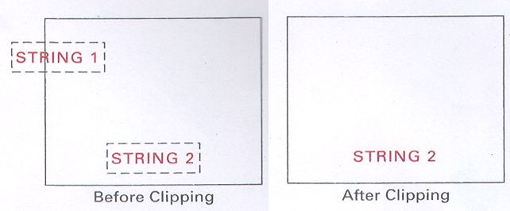
Text Clipping
There are many methods for text clipping which can be used according to application.
All or none string clipping: It is simplest method in which if any portion of text is outside clip window, it will be discarded. This procedure is implemented by considering a bounding rectangle around the text pattern.

Slide 35
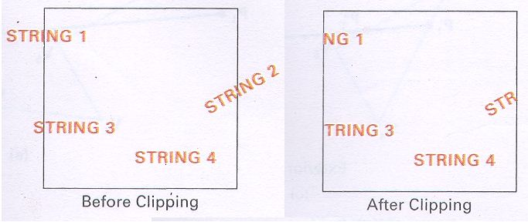
2. All or none character clipping: If any portion of character is outside clip window, it will be discarded.

Slide 36
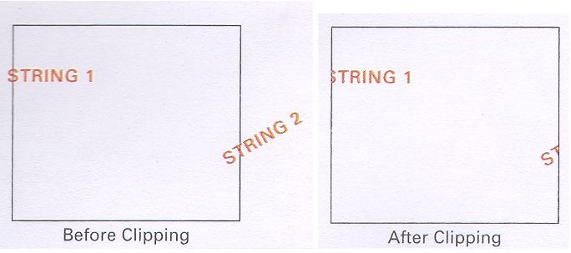
3. Component clipping: The parts of characters which are outside the clip window will be discarded. If an individual character overlaps a clip window boundary, we clip off the parts of the character that are outside the window.

Slide 37
Exterior Clipping
If we want to clip a picture to the exterior of a specified region, exterior clipping is used.
The picture parts to be saved are those that are outside the region. This is referred to as exterior clipping.
A typical example of the application of exterior clipping is in multiple window systems. To correctly display the screen windows, we often need to apply both internal and external clipping.

Slide 38
Three Dimensional Concepts
When we model and display a 3D scene, there are many more considerations we must take into account besides just including coordinate values for the third dimension.
Object boundaries can be constructed with various combinations of plane and curved surfaces.
There are some graphics packages that are use for 3D object representation.
Viewing transformations in 3D are much more complicated because there may be so many parameters to select when specifying how 3D scene is to be mapped to display device.

Slide 39
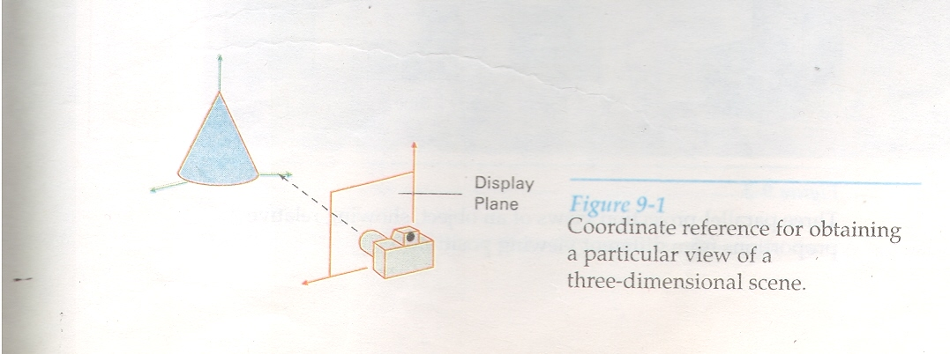

Slide 40
To obtain a display of a 3D scene that has been modeled in world coordinates, we must first set up a coordinate reference for camera.
This coordinate reference defines the position and orientation for the plane of the camera film, which is the plane we want to use to display a view of the object in the scene.
Object descriptions are then transferred to the camera reference coordinates and projected onto the selected display plane.
We can then display the objects in wireframe form.

Slide 41
Parallel Projection
One method of generating a view of solid objects is to project points on the object surface along parallel lines on to the display plane.
By selecting different viewing positions we can project visible points on the object onto the display plane to obtain different two dimensional views of the object.
In a parallel projection parallel lines in the world-coordinate scene project into parallel lines on the two-dimensional display plane.
This technique is used in engineering and architectural drawings to display an object with a set of views that maintain relative proportions of the object.

Slide 42
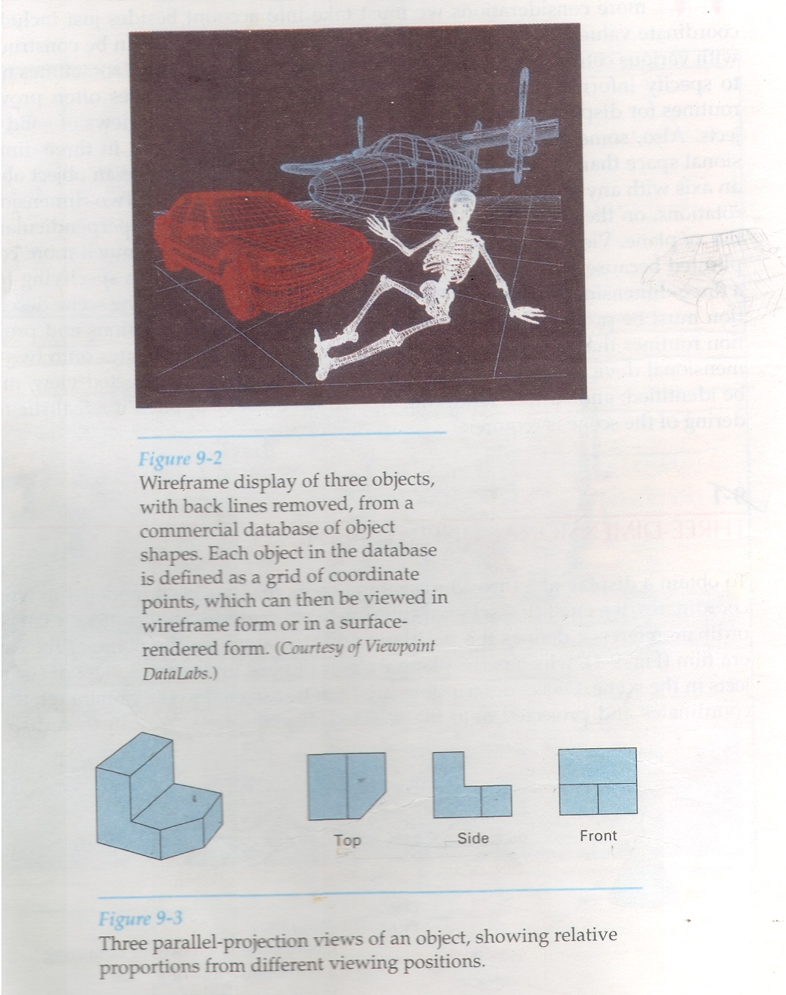

Slide 43
Perspective Projection
Another method of generating a view of a three dimensional scene is to project points to the display plane along converging paths. This causes objects farther from the viewing position to be displayed smaller then the objects of the same size than are nearer to the viewing position.
In perspective projection, parallel lines in a scene that are not parallel to the display plane are projected into converging lines.
Scenes displayed using perspective projection appear more realistic, since this the way that our eyes and camera lens form images.

Slide 44
Depth Cueing
With a few exceptions, depth information is more important, so that we can easily identify for a particular viewing direction, which is the front and which is the back of the displayed objects.
There are several ways to include depth info. in two dimensional representation of the solid objects.
A simple method for indicating depth with wireframe displays is to vary intensity of objects according to their distance from the viewing position. The lines closest to the viewing position are displayed with the highest intensities and lines farther away are displayed with the decreasing intensities.
Depth cueing is applied by choosing maximum and minimum intensity (color values) and a range of distances over which the intensities are to vary.

Slide 45
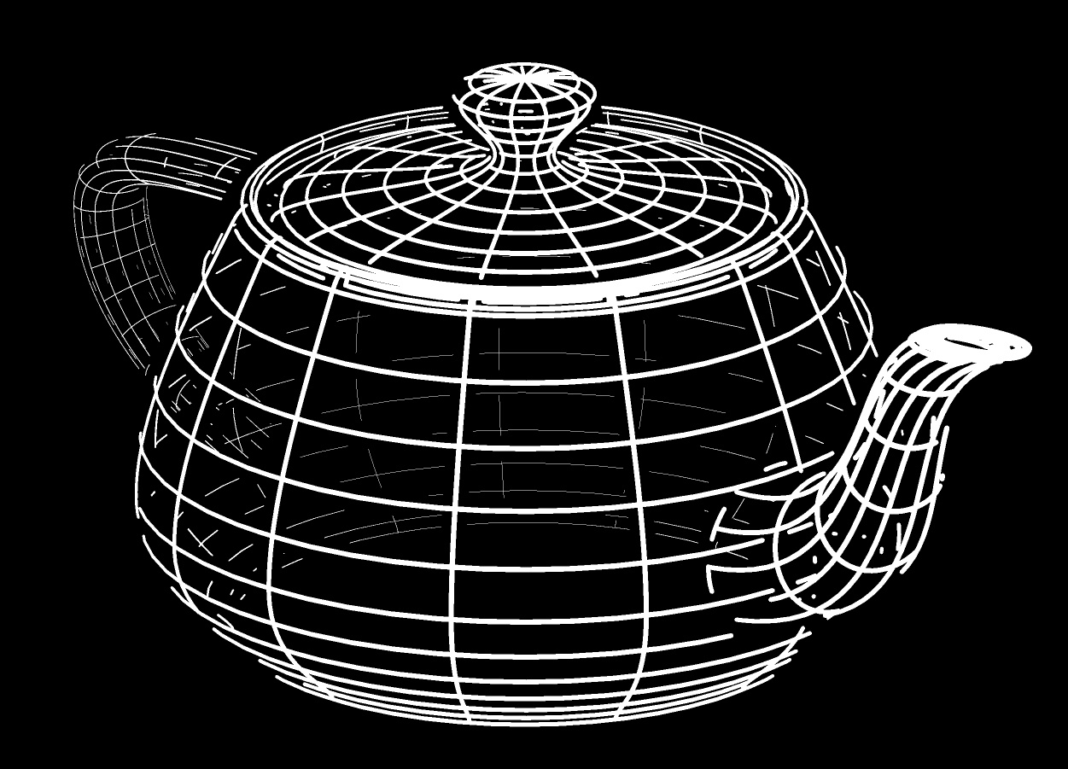
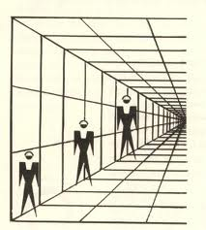

Slide 46
Visible Line and Surface Identification
The simplest method is to highlight the visible lines or to display them in a different color.
Another technique, commonly used for engineering drawings, is to display the non-visible lines as dashed lines.
Another approach is to simply remove the non-visible lines.
When objects are to be displayed with color or shaded surfaces, we apply surface-rendering procedures to the visible surfaces so that the hidden surfaces are obscured.

Slide 47
Surface Rendering
Added realism is attained in displays by setting the surface intensity of objects according to the lighting conditions in the scene and according to assigned surface characteristics.
Lighting specifications include the intensity and positions of light sources and the general background illumination required for a scene.
Surface properties of objects include degree of transparency and how rough or smooth the surfaces are to be.

Slide 48
Three Dimensional Object Representations
Representation schemes for solid objects are often divided into two broad categories, although not all representations fall neatly into any one of two categories:
Boundary representations ( B-reps).
Space-partitioning representations
Boundary representations ( B-reps) :
This describes a three-dimensional objects as a set of surfaces that separate the object interior from the environment.
Space-partitioning representations
They are used to describe interior properties, by partitioning the spatial region containing an object into a set of small, non-overlapping, contiguous solids (usually cubes).

Slide 49
Polygon Surfaces
It is example of boundary representation method.
It simplify and speed up the surface rendering and display of objects, since all the surface are described with linear equations.
Polygon Tables
we specify the polygon surface with a set of vertex coordinate and associated attribute parameters.
Polygon data table can be organized in two way:
Geometric table
Attribute table

Slide 50
Geometric data tables contains vertex coordinate and parameter to identify the spatial orientation of the polygon surface.
Attribute data table includes texture characteristics and its surface reflectivity.
A convenient organization for storing geometric data is to create three list:
A vertex table
An edge table
A polygon table
Coordinate value for each vertex of an object is stored in vertex table.
Edge table contains pointers back into vertex table to identify the vertices of each polygon edge.
Polygon table contains pointer back into edge table to identify the edges for each polygon.

Slide 51
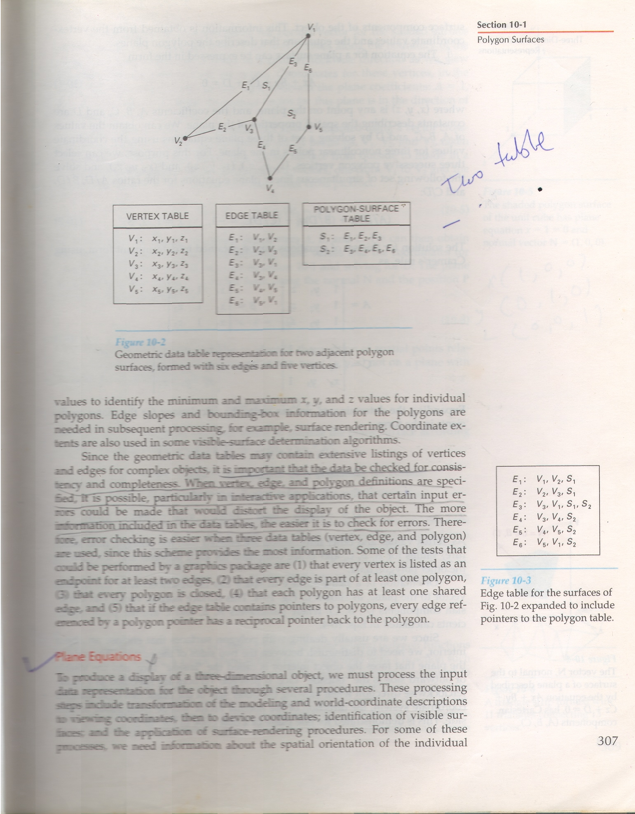

Slide 52
Curved Lines and Surfaces
Displays of three-dimensional curved lines and surfaces can be generated from an input set of mathematical functions defining the objects or from a set of user specified data points.
When functions are specified, a package can project the defining equations for a curve to the display plane and plot pixel positions along the path of the projected function.

Slide 53
Quadric Surfaces
Frequently used classes of objects are the quadric surfaces, which are described with second-degree equations (quadratics). They include spheres, ellipsoids, paraboloids, and hyperboloids.
Quadric surfaces, particularly spheres and ellipsoids, are common elements of graphics scenes, and they are often available in graphics packages as primitives from which more complex objects can be constructed.

Slide 54
Blobby Objects
Some objects do not maintain a fixed shape, but change their surface characteristics in certain motions or when in proximity to other objects.
Examples in this class of objects include molecular structures, water droplets, muscle shapes in the human body etc.
These objects can be described as exhibiting “blobbiness” and are often simply referred to as blobby objects, since their shapes show a certain degree of fluidity.

Slide 55
Spline Representations
In drafting terminology, a Spline is a flexible strip used to produce a smooth curve through a designated set of points.
Several small weights are distributed along the length of the strip to hold it in position on the drafting table as the curve is drawn.
The term spline curve originally referred to a curve drawn in this manner.
In computer graphics, the term spline curve now refers to any composite curve formed with polynomial sections satisfying specified continuity conditions at the boundary of the pieces.
A spline surface can be described with two sets of orthogonal spline curves.

Slide 56
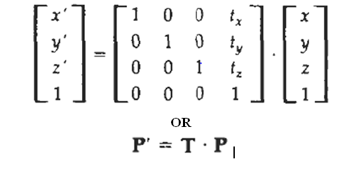
3-D Transformations
TRANSLATION
In a three-dimensional homogeneous coordinate representation, a point is translated from position P = (x, y, z) to position P' = (x', y', z') with the matrix operation

Slide 57
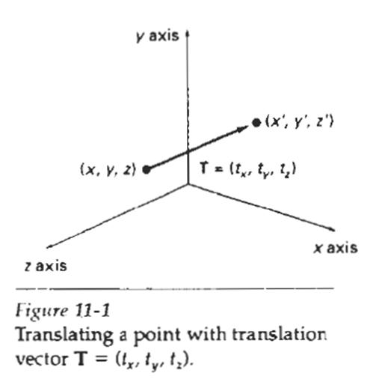
Translation
Parameters t_{x} t_{y} and t_{z} specifying translation distances for the coordinate directions x, y, and z, are assigned any real values. The matrix representation in Eq. 11-1 is equivalent to the three equations
x' = x + t_{x} ,
y ' = y + t_{y} ,
z ' = z + t_{z}

Slide 58
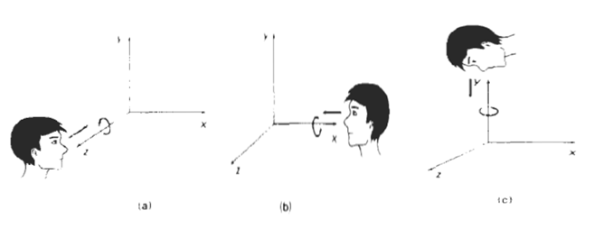
Rotation
To generate a rotation transformation for an object, we must designate an axis of rotation (about which the object is to be rotated) and the amount of angular rotation.

Slide 59
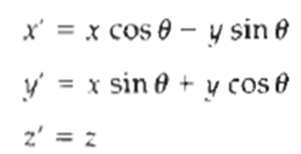
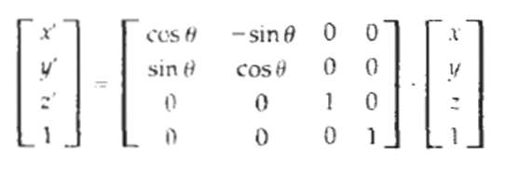
Rotation
The two-dimensional z-axis rotation equations are easily extended to three dimensions:

Slide 60
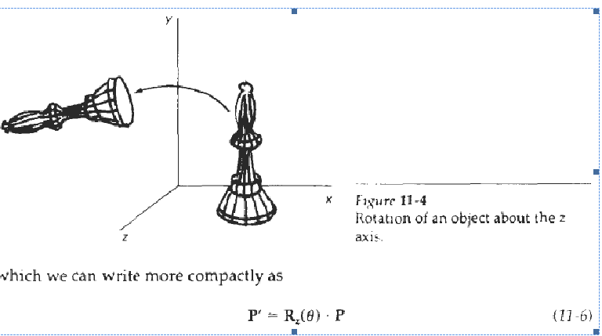
Rotation

Slide 61
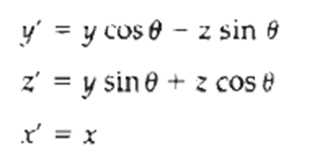
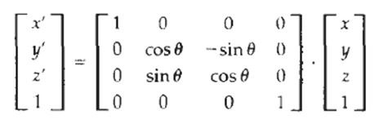
Rotation
The equations for an x-axis rotation:

Slide 62
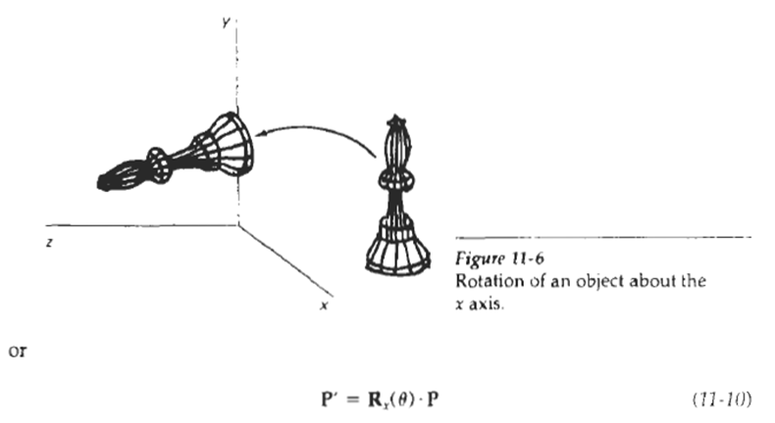
Rotation

Slide 63
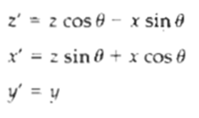
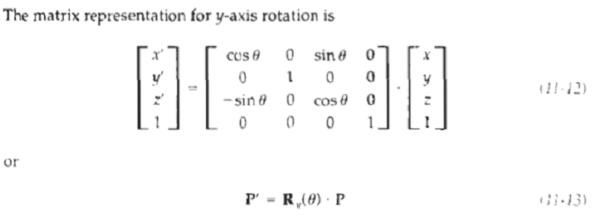
Rotation
the transformation equations for a y-axis rotation:

Slide 64
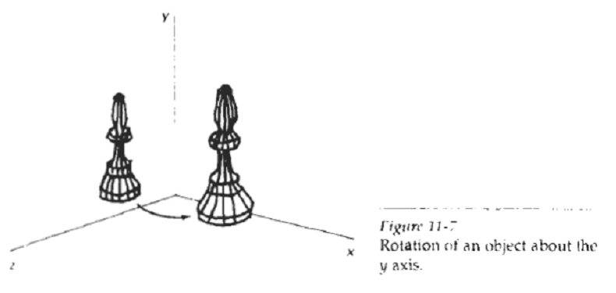
Rotation

Slide 65
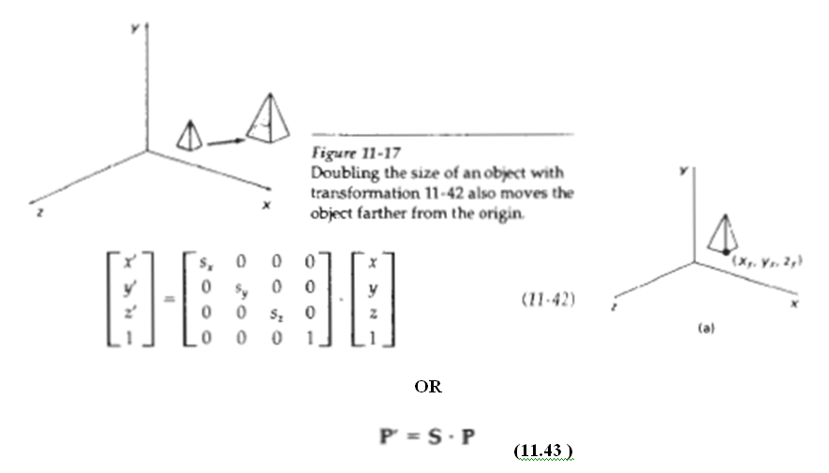
Scaling

Slide 66
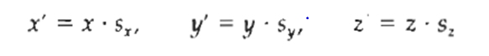
Scaling
Explicit expressions for the coordinate transformations for scaling relative to the origin are
Scaling with respect to a selected fixed position (Xf, Yf, Zf,) can be represented with the following transformation sequence:
1. Translate the fixed point to the origin.
2. Scale the object relative to the coordinate origin using Eq. 11-42.
3. Translate the fixed point back to its original position.

Slide 67
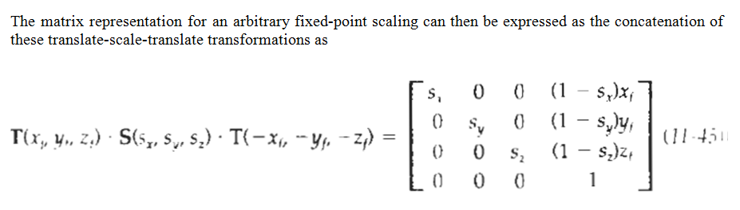
Scaling

Slide 68
Visible Surface Detection
A major consideration in the generation of realistic graphics displays is identifying those parts of a scene that are visible from a chosen viewing position.
Numerous algorithms have been devised for efficient identification of visible objects for different types of applications.
Some methods require more memory, some involve more processing time, and some apply only to special types of objects.

Slide 69
Classification of Visible Surface Detection Algorithms
An object-space method compares objects and parts of objects to each other within the scene definition to determine which surfaces, as a whole, we should label as visible.
In an image-space algorithm, visibility is decided point by point at each pixel position on the projection plane. Most visible-surface algorithms use image-space methods,
Line display algorithms, on the other hand, generally use object-space methods to identify visible lines in wire frame displays, but many image-space visible-surface algorithms can be adapted easily to visible-line detection.

Slide 70
BACK-FACE DETECTION
The equation for a plane surface can be expressed in the form:
Ax + By + Cz + D = 0
where (x, y, z) is any point on the plane, and the coefficients A, B, C, D are constants describing the spatial properties of the plane.
A fast and simple object-space method for identifying the back faces of a polyhedron is based on the "inside-outside" tests.
A point (x, y, z) is "inside" a polygon surface with plane parameters A, B, C, and D if
Ax + By + Cz + D < 0
When an inside point is along the line of sight to the surface, the polygon must be a back face.

Slide 71
DEPTH-BUFFER/Z-BUFFER METHOD
A commonly used image-space approach to detecting visible surfaces is the depth-buffer method, which compares surface depths at each pixel position on the projection plane.
This procedure is also referred to as the z-buffer method, since object depth is usually measured from the view plane along the z axis of a viewing system.
Each surface of a scene is processed separately, one point at a time across the surface.
For each pixel position (x, y) on the view plane, object depths can be compared by comparing z values.

Slide 72
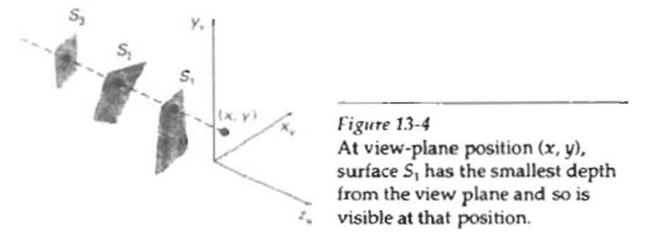
DEPTH-BUFFER/Z-BUFFER METHOD
Following figure shows three surfaces at varying distances along the orthographic projection line from position (x,y ) in a view plane taken as the XvYv plane.
Surface S1, is closest at this position, so its surface intensity value at (x, y) is saved.

Slide 73
DEPTH-BUFFER/Z-BUFFER METHOD
As implied by the name of this method, two buffere areas are required:
A depth buffer is used to store depth values for each (x,y) position as surfaces are processed, and
The refresh buffer stores the intensity values for each position
Initially, all positions in the depth buffer are set t0 0(minimum depth).
The refresh buffer is initialized to the background intensity.

Slide 74
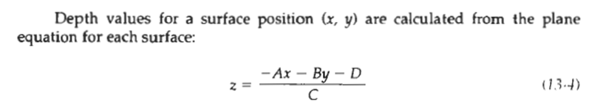
DEPTH-BUFFER/Z-BUFFER METHOD
Each surface listed in the polygon tables is then processed, one scan line at a time, calculating the depth (z value) at each (x,y) pixel position.
The calculated depth is compared to the value previously stored in the depth buffer is at that position.
If the calculated depth is greater than the value stored in the depth buffer, the new depth value is stored, and the surface intensity at that position is determined and placed in the same x,y location in the refresh buffer.

Slide 75
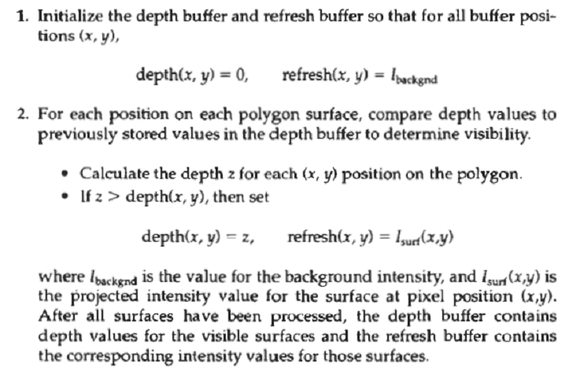
Steps of Z-Buffer Algorithm

Slide 76
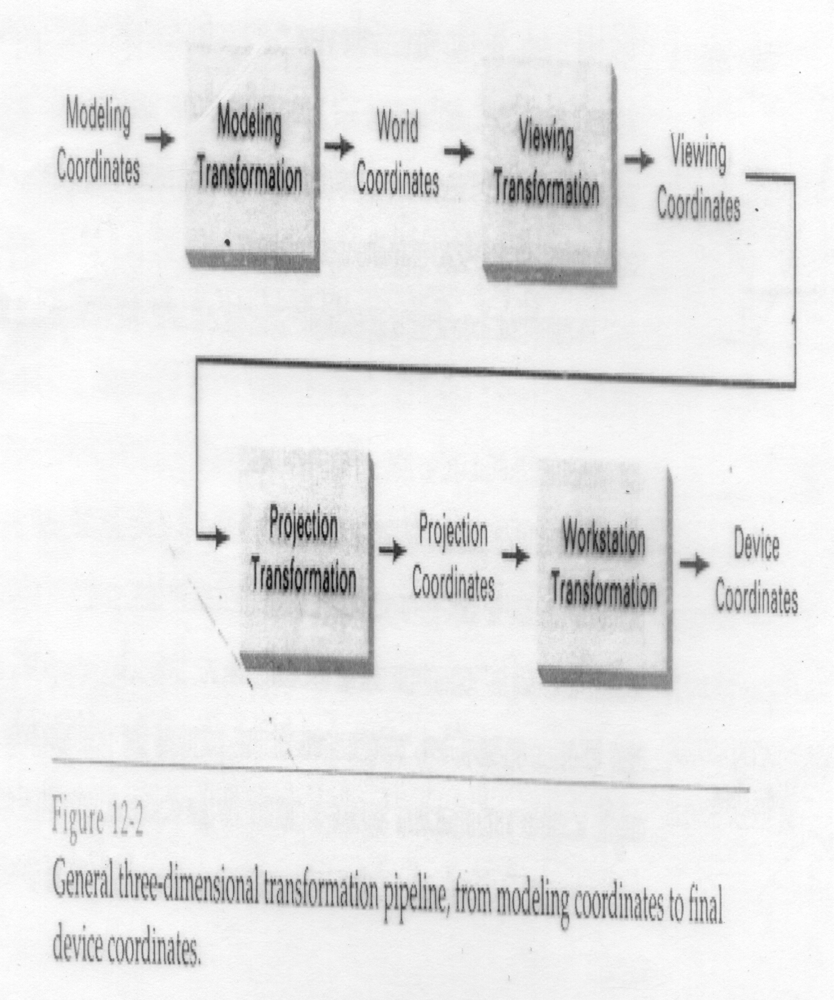
3D Transformation Pipeline

